Slide 1

PSRule deep-dive with Rule development best practices
Georgi Ivanov

Slide 2






Thanks to our sponsors:
#PSSATKA

Slide 3
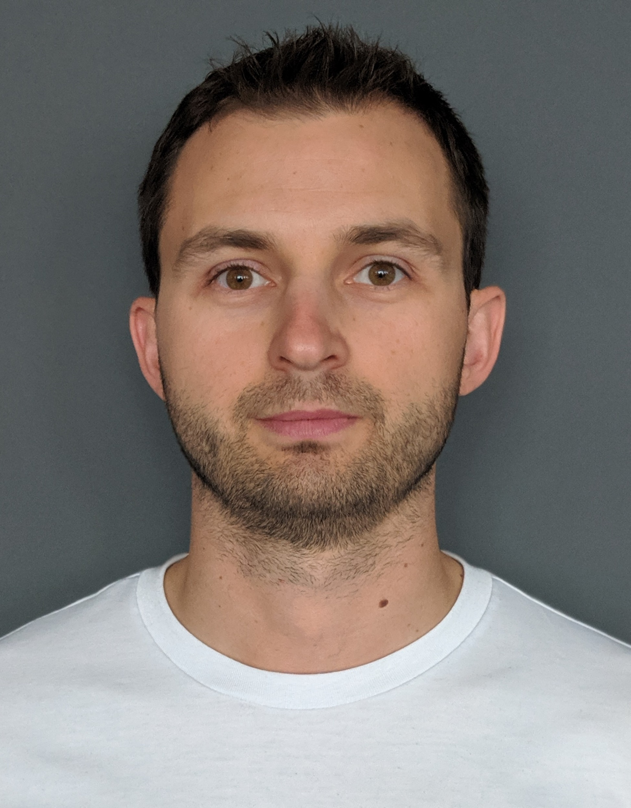




About me
30. November 2024
Trainer
Speaker at PowerShell UG BG
Technology Lead Automation
linkedin.com/in/gogivanov
github.com/gogbg/pssatka
#PSSATKA

Slide 4
Agenda
My use case
PSRule overview [with demo]
Develop custom rules [with demo]
PSRule pipeline [with demo]
Distribute rules [with demo]
Example PS Rule module [with demo]
#PSSATKA

Slide 5
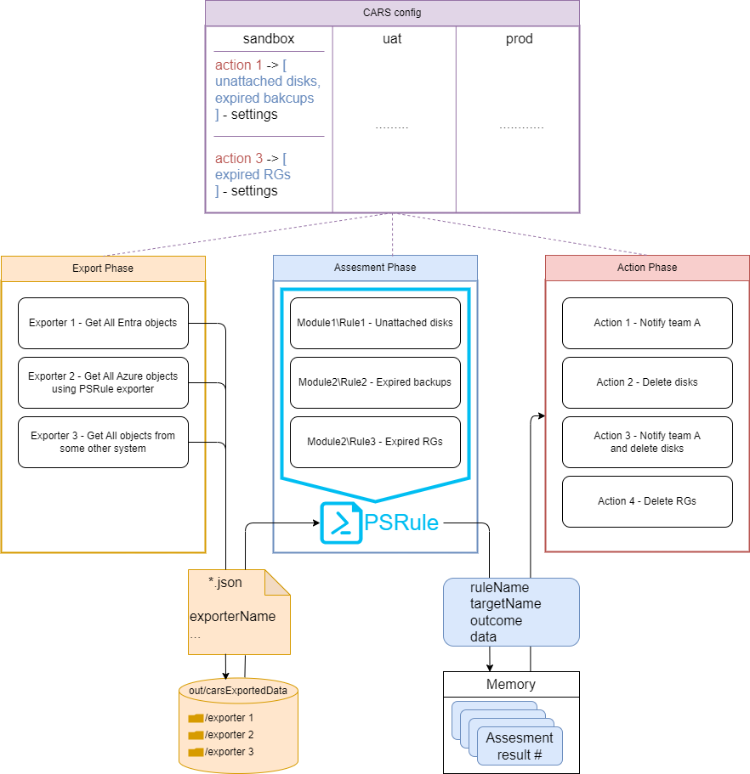
My use case
Continuous
Assessment
and
Remediation System
#PSSATKA

Slide 6
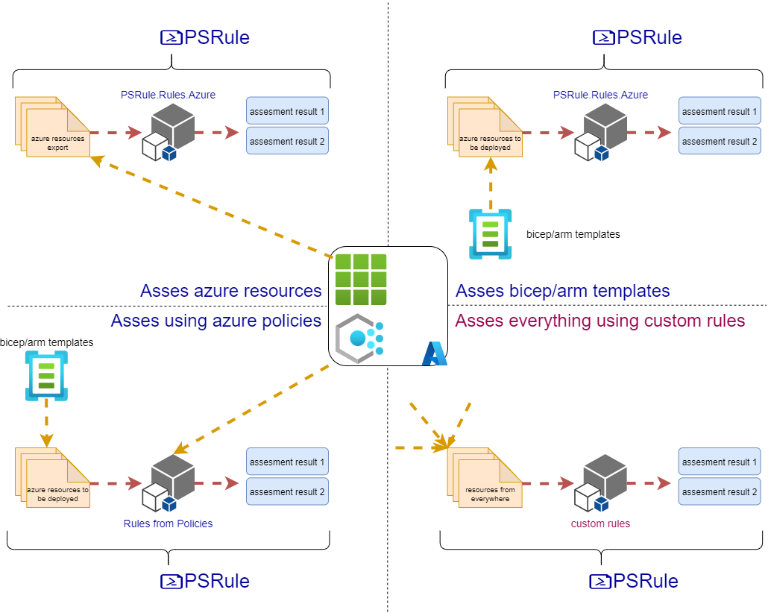
PSRule overview
#PSSATKA

Slide 7

DEMO – Not to focus on
#PSSATKA

Slide 8
DEMO – Develop custom rules
#PSSATKA

Slide 9
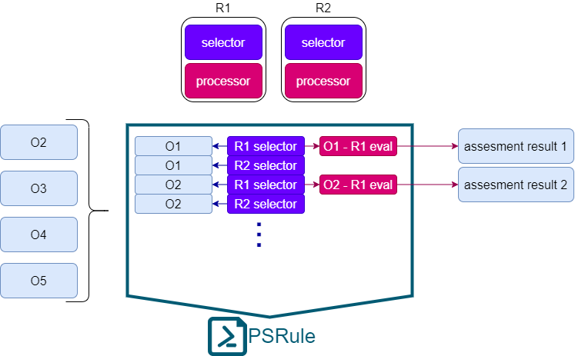
PSRule pipeline [rules only]
#PSSATKA

Slide 10
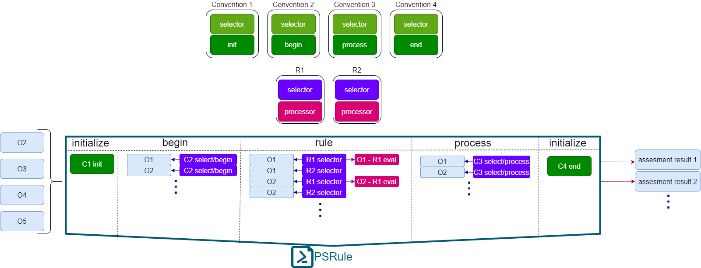
PSRule pipeline [with conventions]
#PSSATKA

Slide 11
DEMO – PSRule pipeline
#PSSATKA

Slide 12
DEMO – Distribute rules
#PSSATKA

Slide 13
DEMO – Example PS Rule module
#PSSATKA

Slide 14

QnA
#PSSATKA

Slide 15

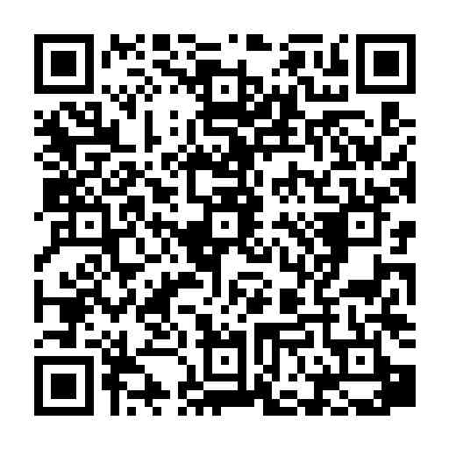
Rate this session
Giving feedback is like wrapping a Christmas gift: thoughtful, personal, and meant to bring joy.
#PSSATKA

Slide 16
Thanks for your attention and all the fish
#PSSATKA

